Slide 1
The FQHE on cylinder

Slide 2
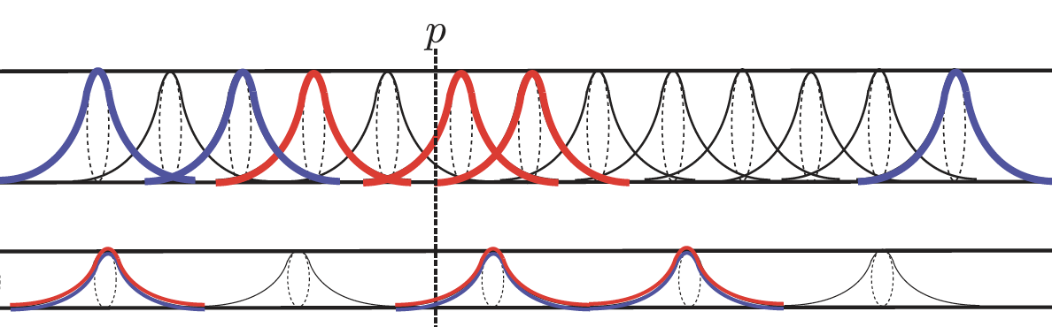
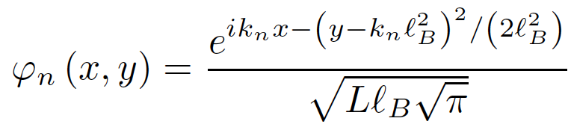
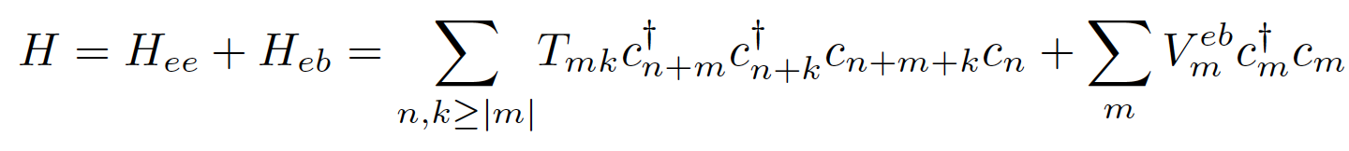
Cylinder
In second quantization, the Coulomb interaction between the electrons in the lowest LL is

Slide 3
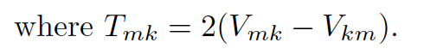
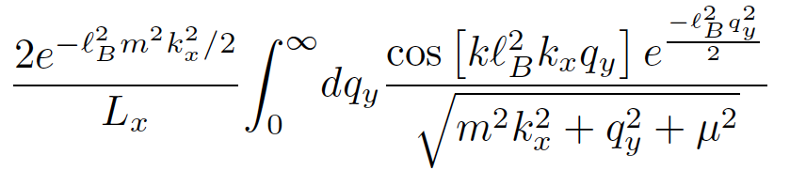
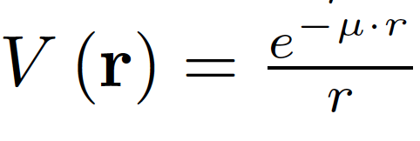
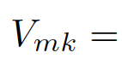
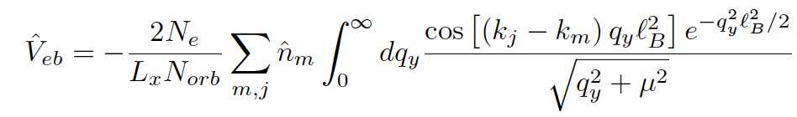
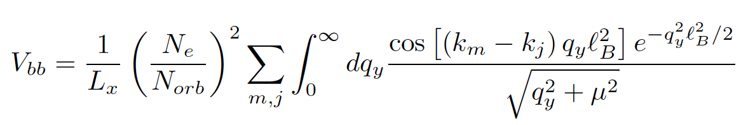
Electron-background term
Nonuniform background case
Background-background term
Nonuniform background case

Slide 4
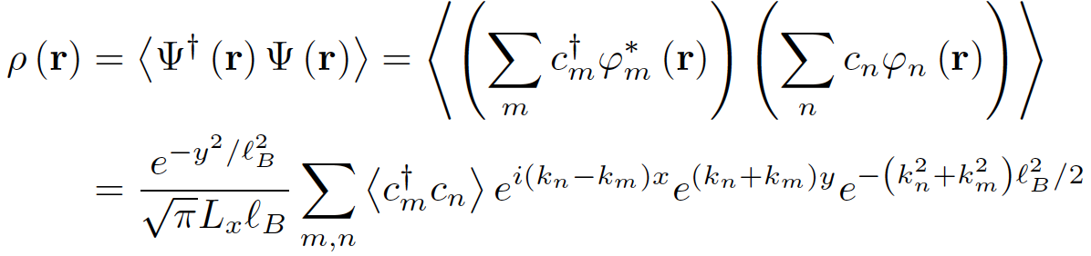
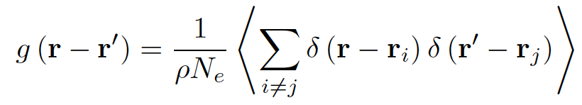
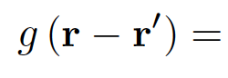
electron density(charge profile)
pair correlation function

Slide 5
N =6

Slide 6
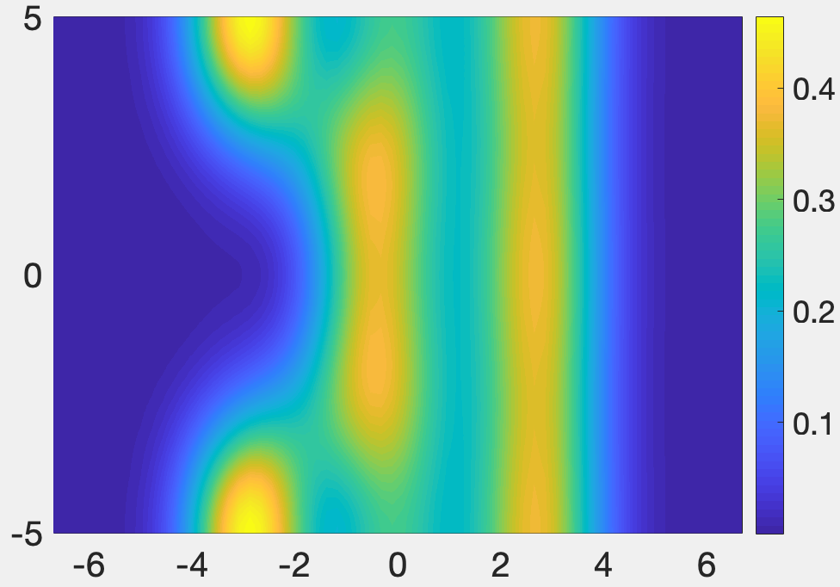
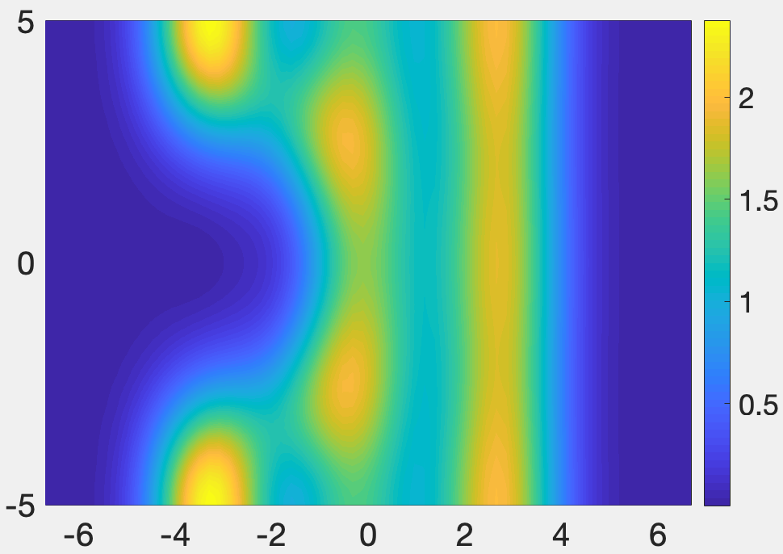
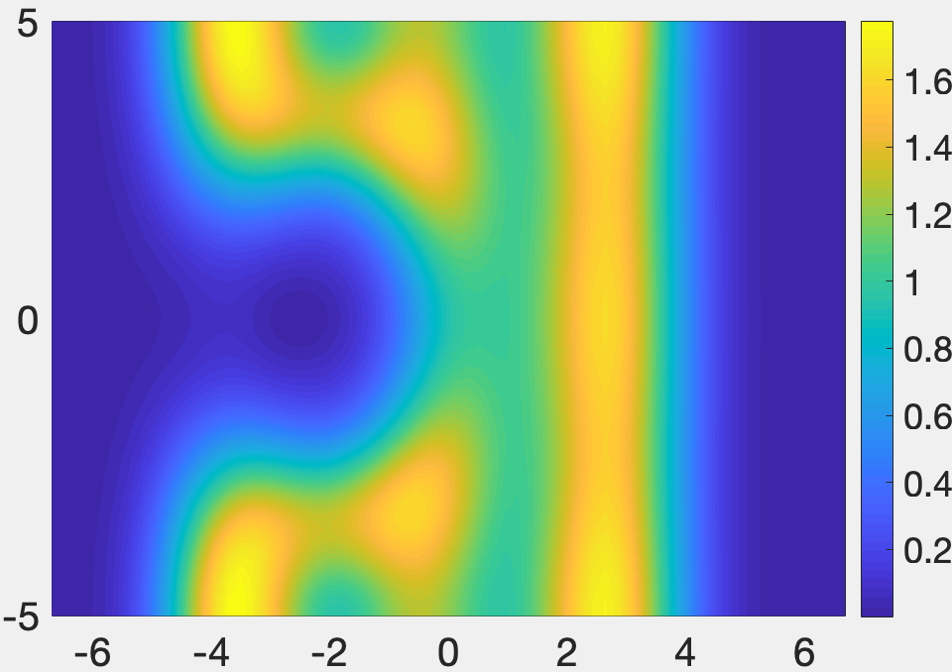
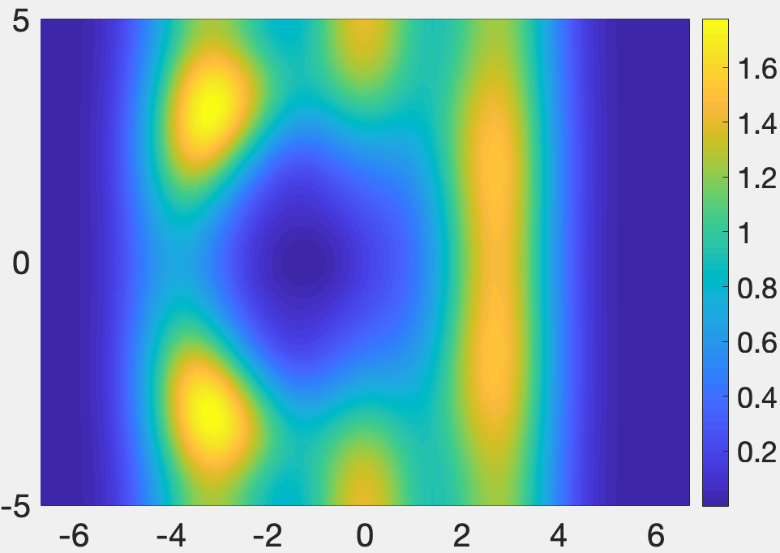
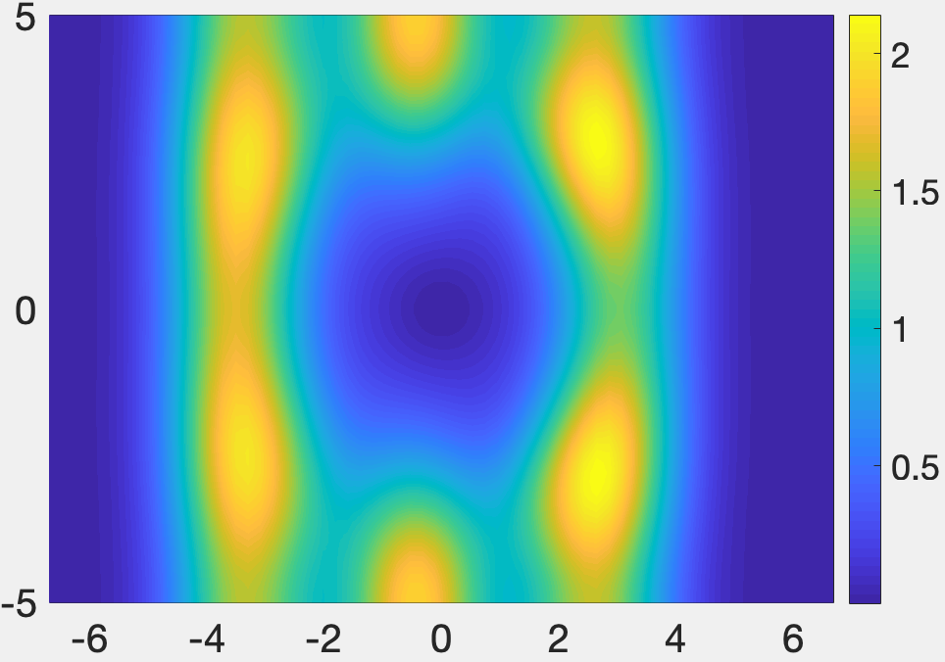
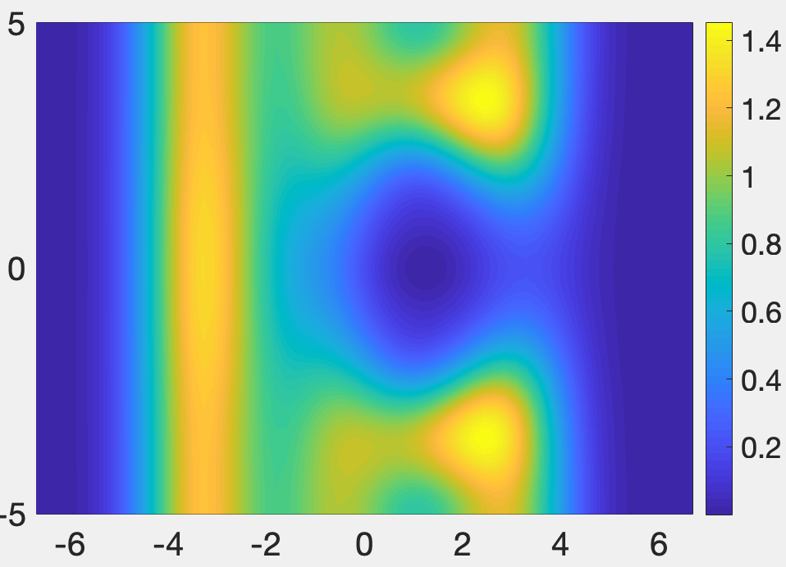
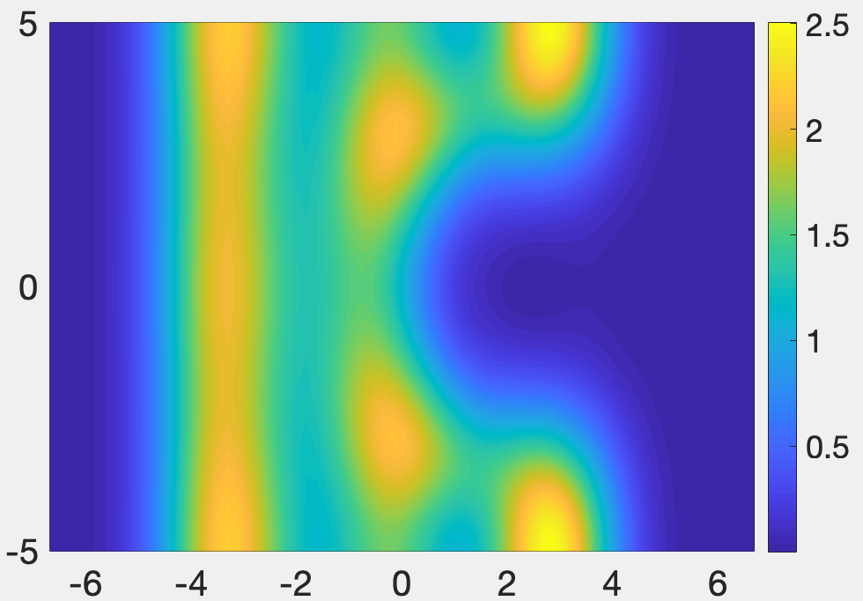
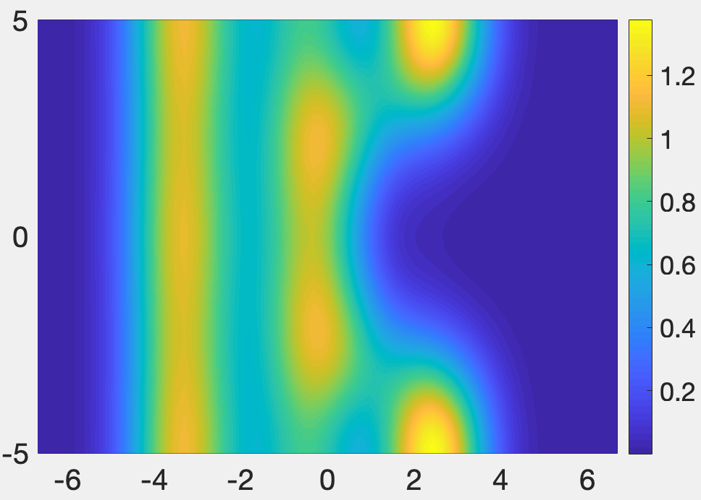
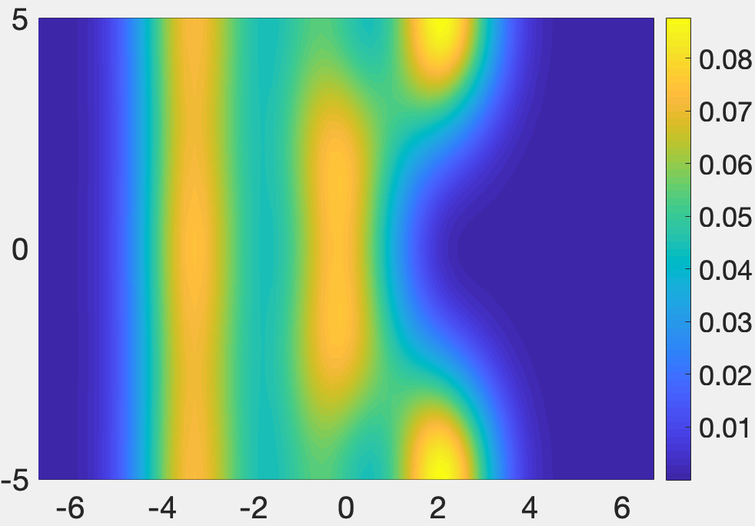
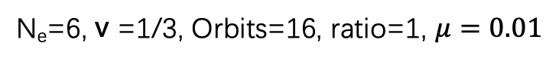
N_{e}=6, v =1/3, Orbits=16, ratio=1, $μ=0.01$
Nonuniform background case
Pair correlation function

Slide 7
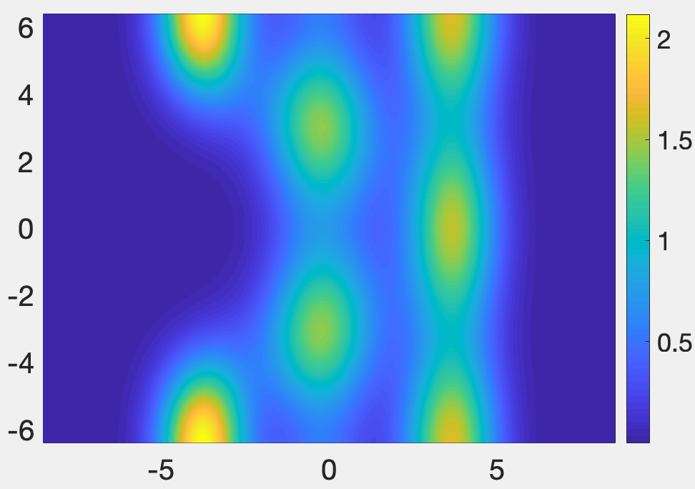
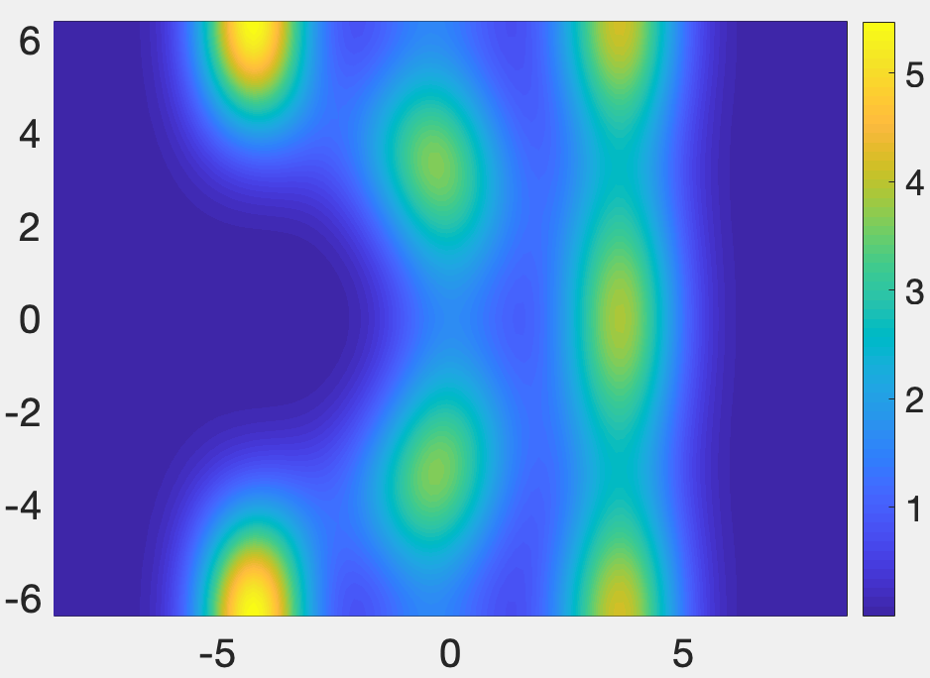
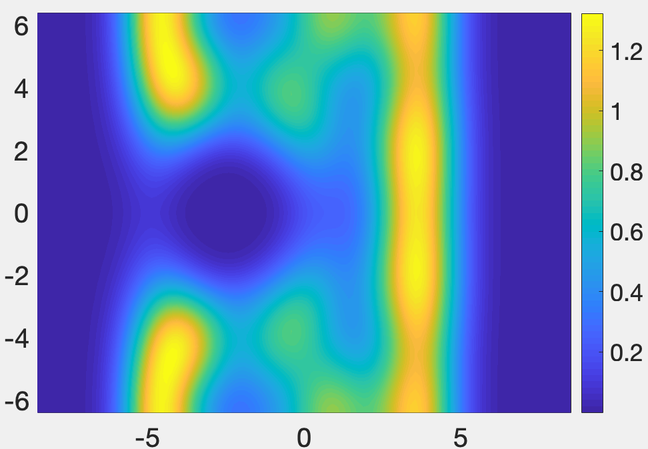
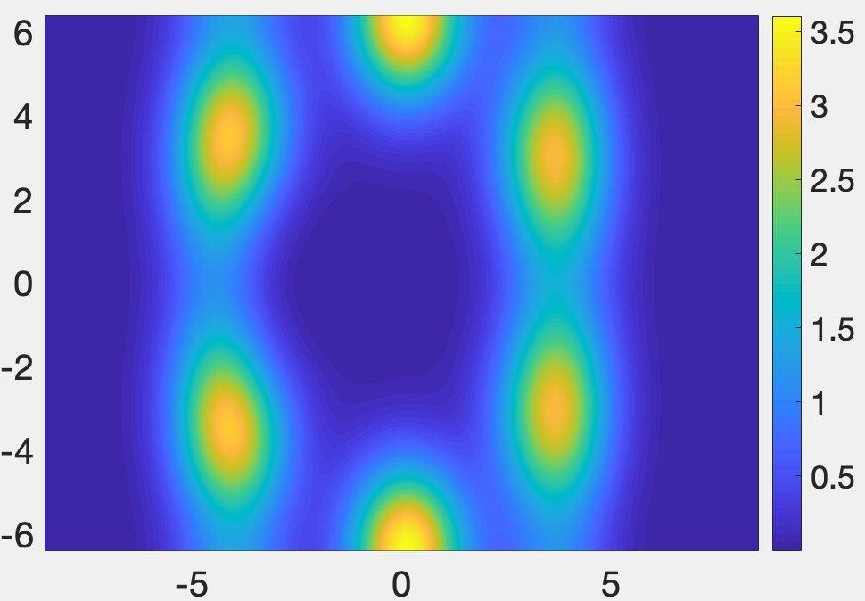
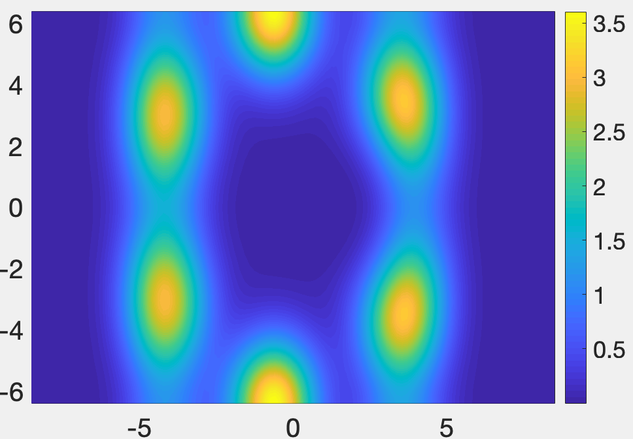
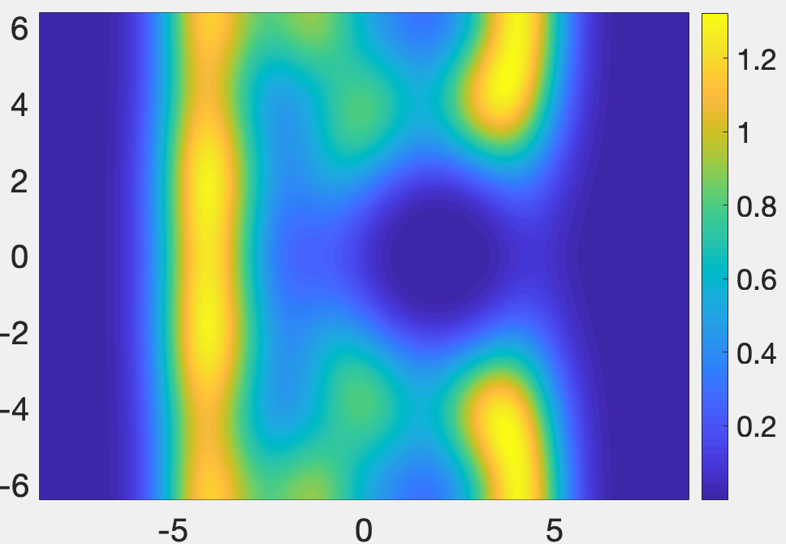
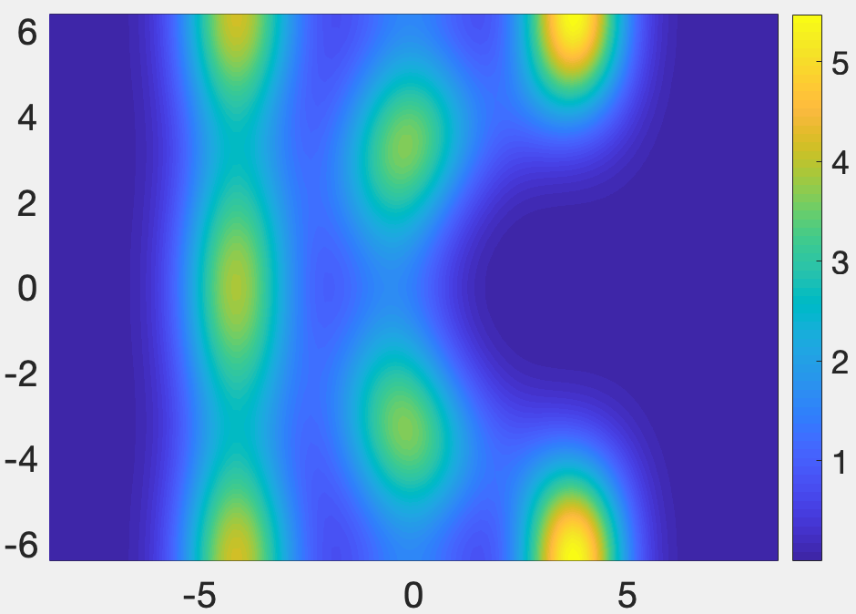
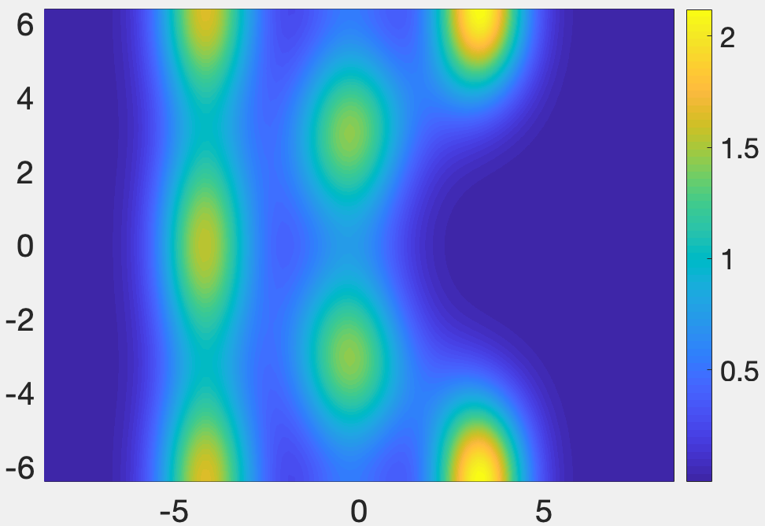
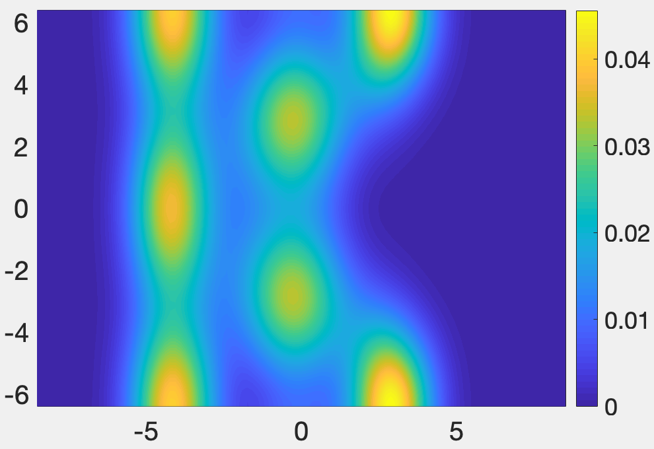
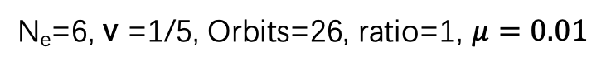
N_{e}=6, v =1/5, Orbits=26, ratio=1, $μ=0.01$
Nonuniform background case
Pair correlation function

Slide 8
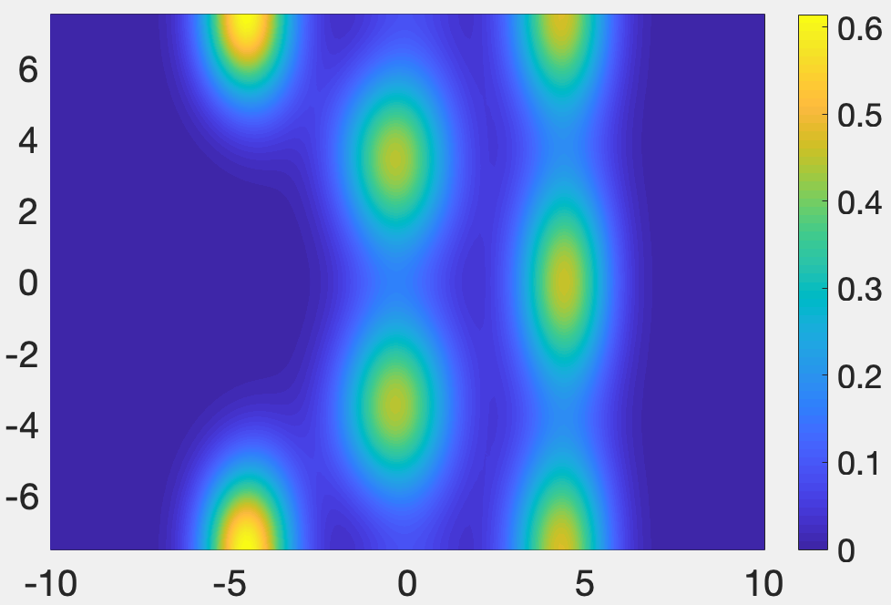
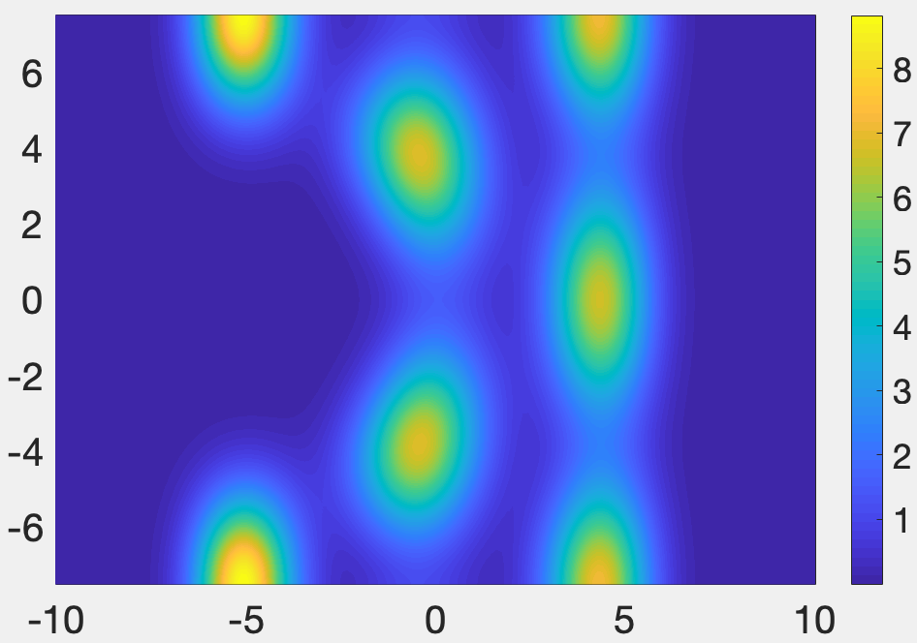
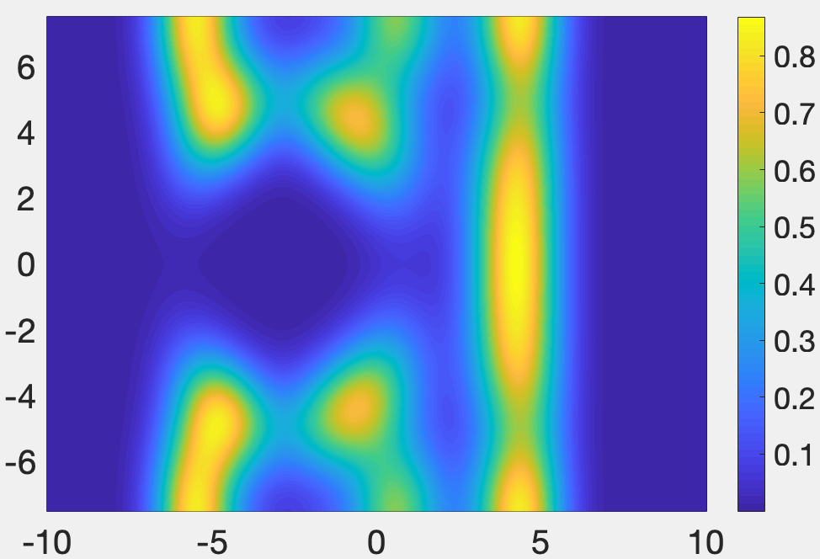
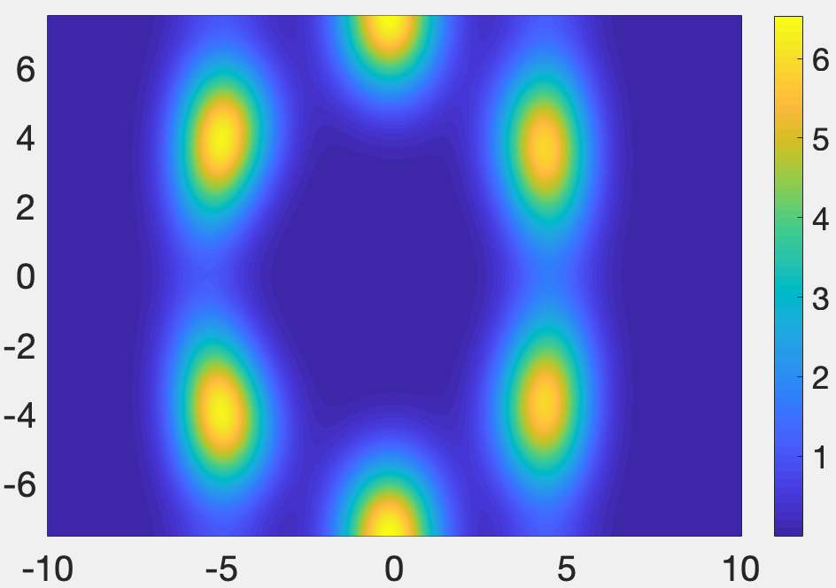
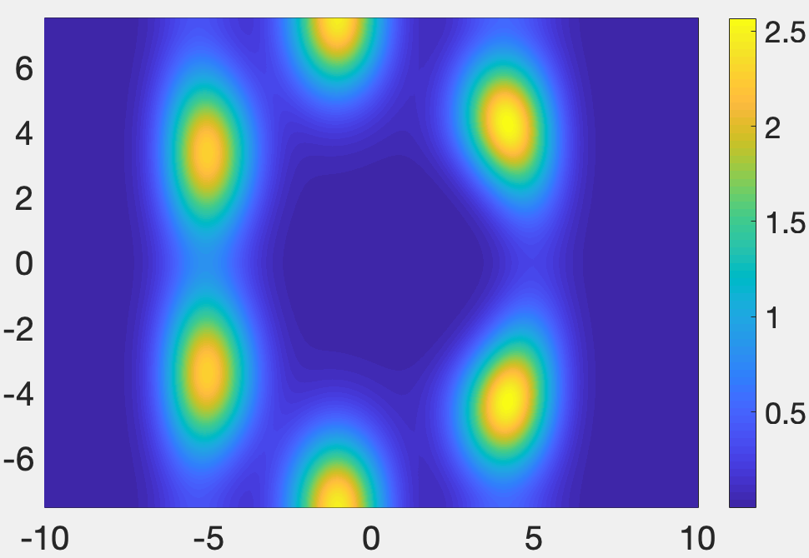
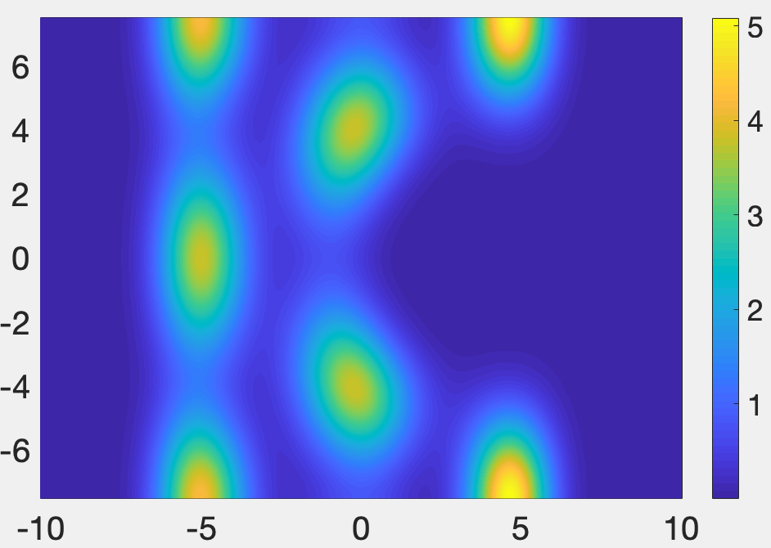
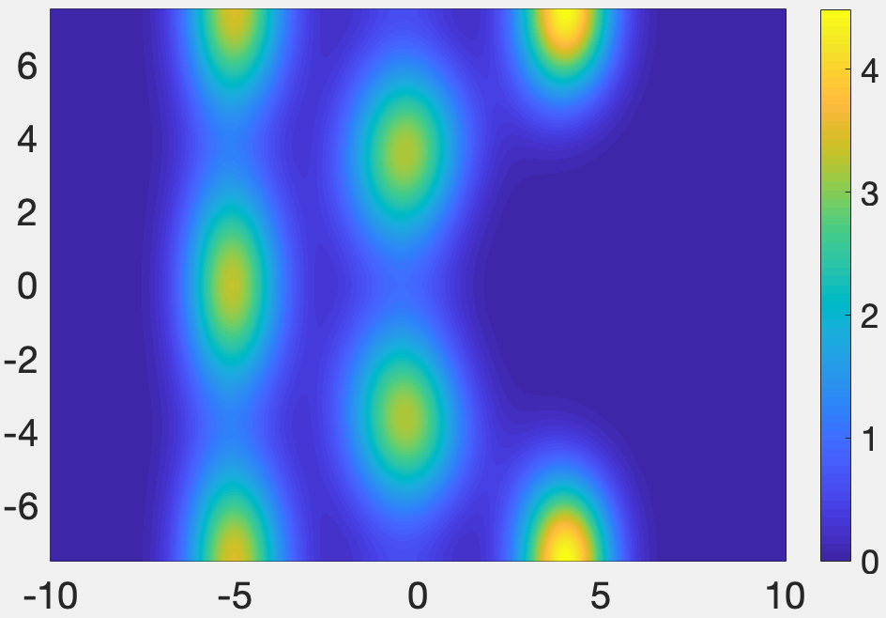
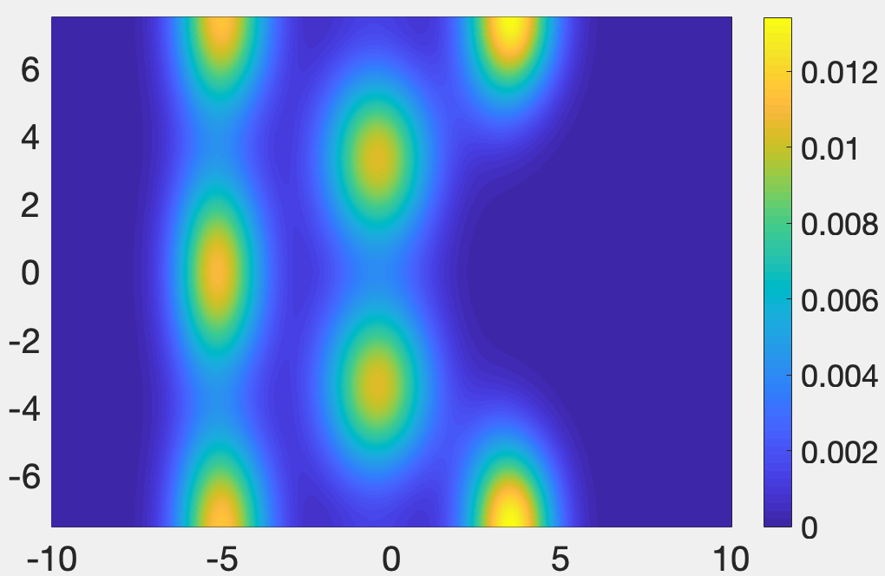
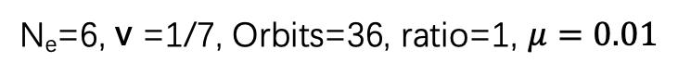
N_{e}=6, v =1/7, Orbits=36, ratio=1, $μ=0.01$
Nonuniform background case
Pair correlation function

Slide 9
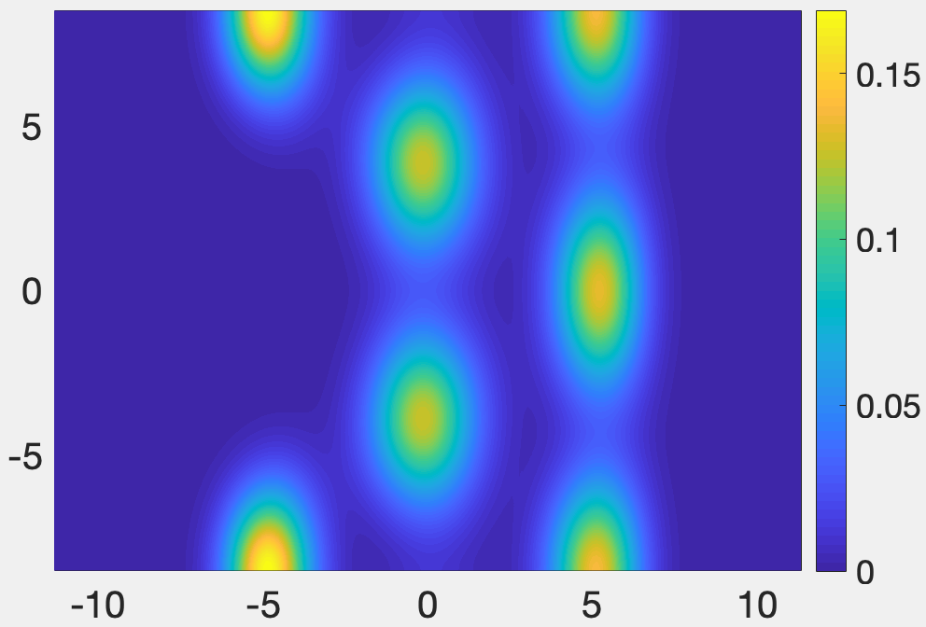
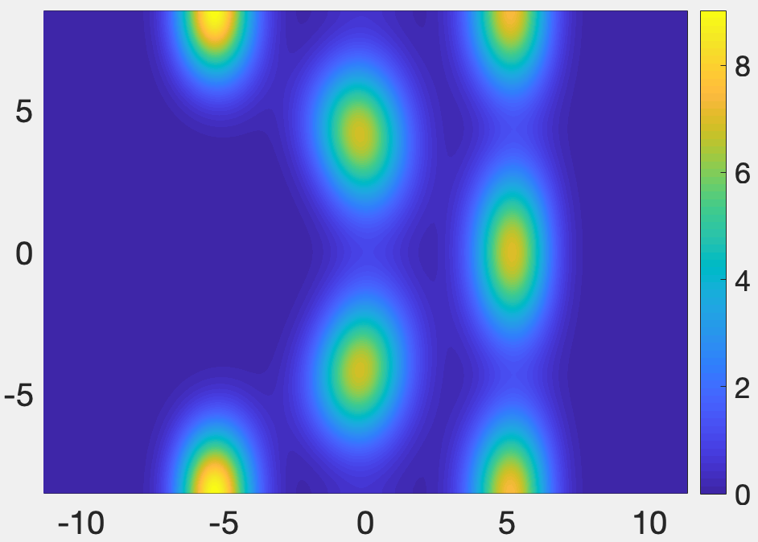
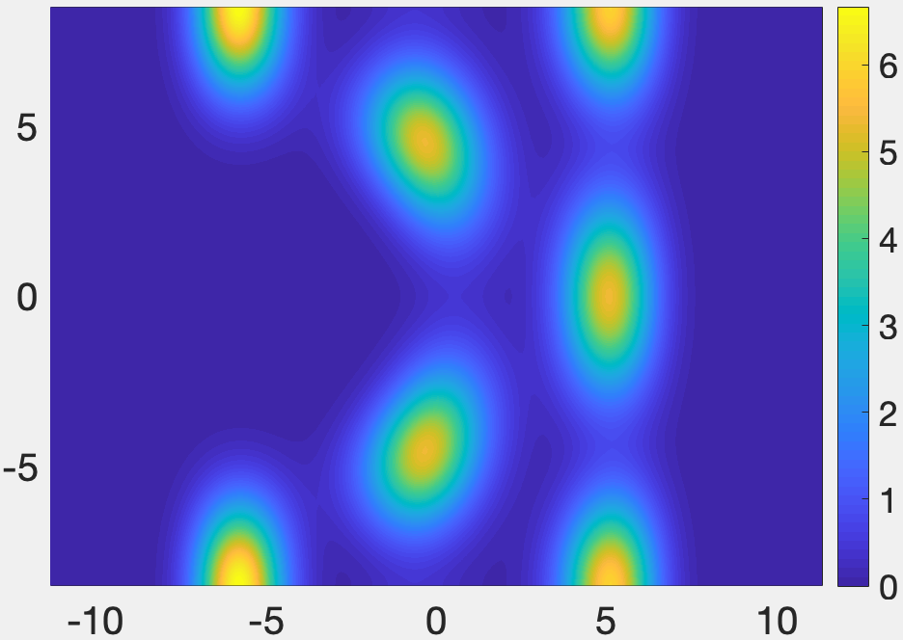
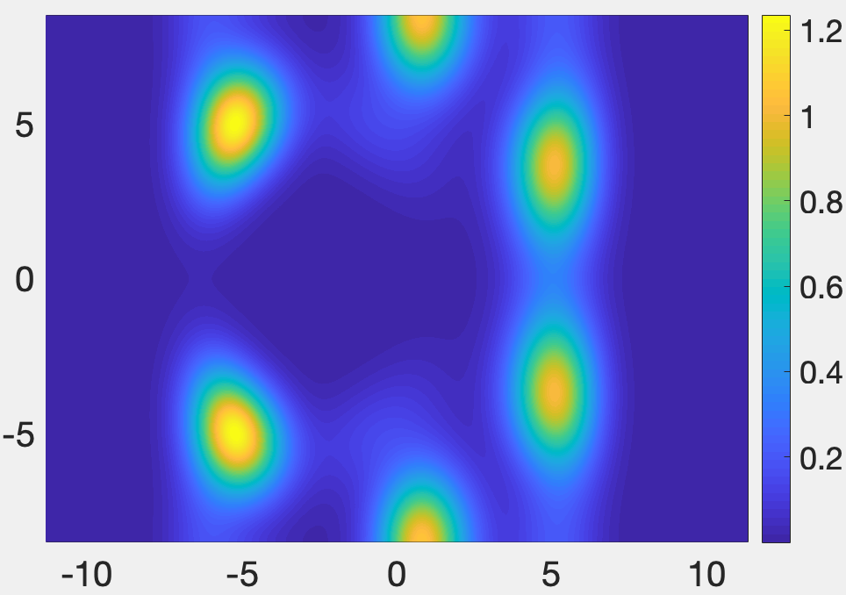
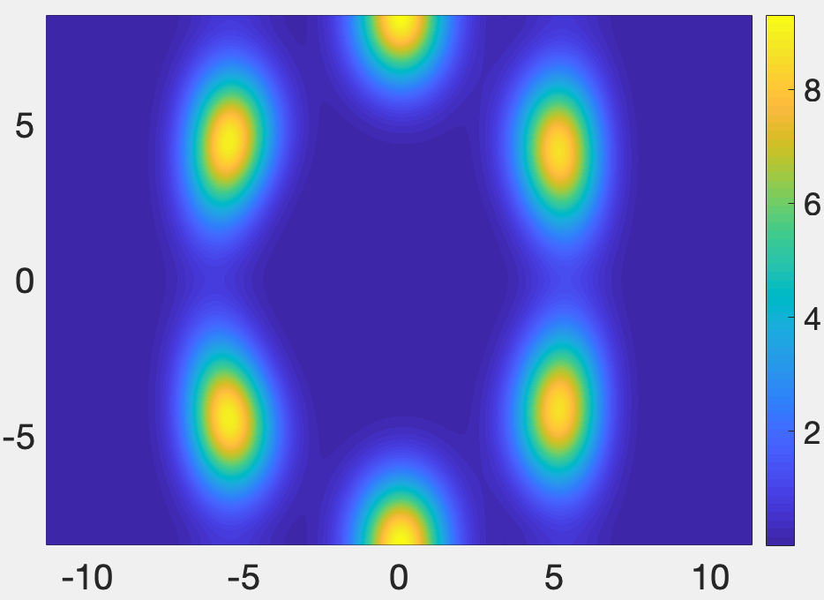
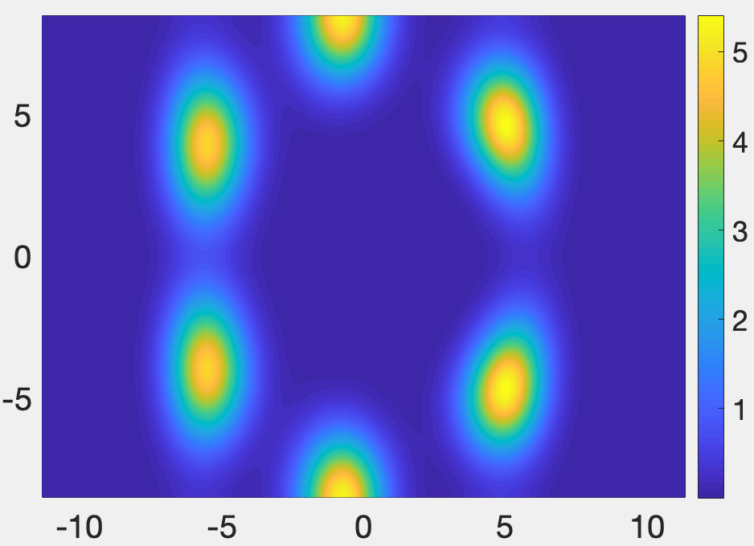
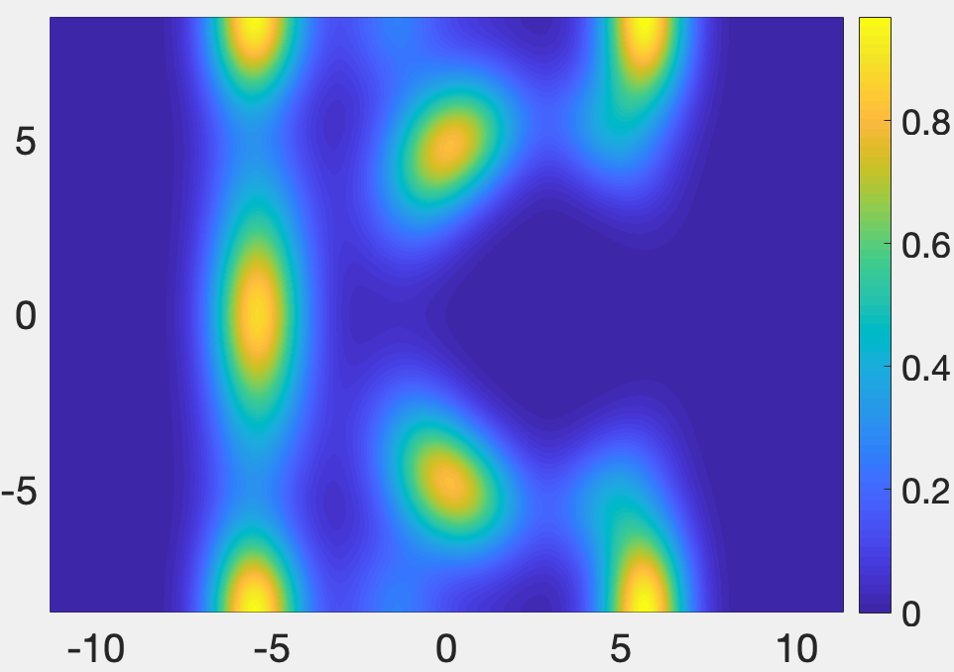
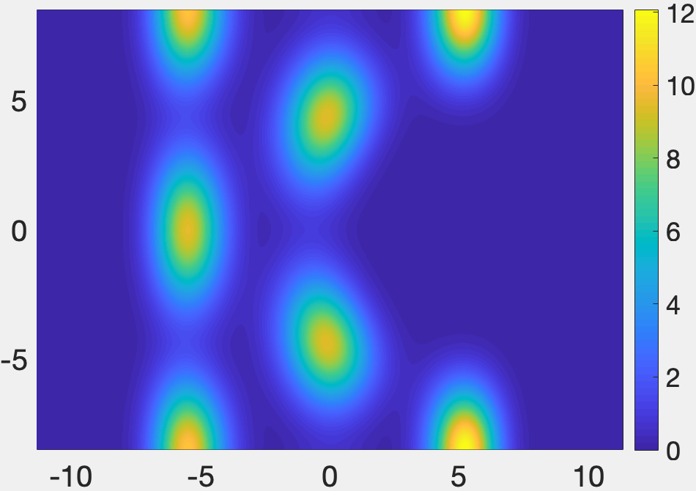
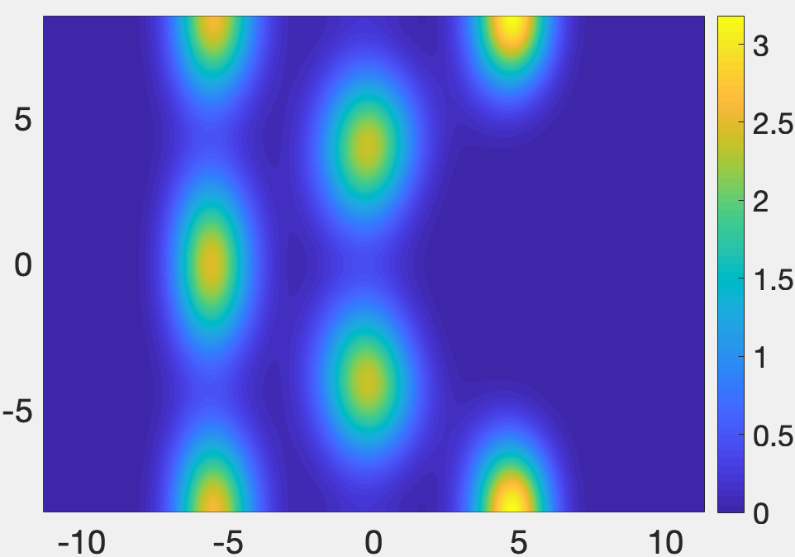


N_{e}=6, v =1/9, Orbits=46, ratio=1, $μ=0.01$
Nonuniform background case
Pair correlation function

Slide 10










N_{e}=6, v =1/11, Orbits=56, ratio=1, $μ=0.01$
Nonuniform background case
Pair correlation function

Slide 11
N =7

Slide 12











N_{e}=7, v =1/3, Orbits=19, ratio=1, $μ=0.01$
Nonuniform background case
Pair correlation function

Slide 13









N_{e}=7, v =1/5, Orbits=31, ratio=1, $μ=0.01$
Nonuniform background case
Pair correlation function

Slide 14










N_{e}=7, v =1/7, Orbits=43, ratio=1, $μ=0.01$
Nonuniform background case
Pair correlation function

Slide 15













N_{e}=7, v =1/9, Orbits=55, ratio=1, $μ=0.01$
Nonuniform background case
Pair correlation function

Slide 16













N_{e}=7, v =1/11, Orbits=67, ratio=1, $μ=0.01$
Nonuniform background case
Pair correlation function

Slide 17
N =8

Slide 18









N_{e}=8, v =1/3, Orbits=22, ratio=1, $μ=0.01$
Nonuniform background case
Pair correlation function

Slide 19











N_{e}=8, v =1/5, Orbits=36, ratio=1, $μ=0.01$
Nonuniform background case
Pair correlation function

Slide 20












N_{e}=8, v =1/7, Orbits=50, ratio=1, $μ=0.01$
Nonuniform background case
Pair correlation function

Slide 21












N_{e}=8, v =1/9, Orbits=64, ratio=1, $μ=0.01$
Nonuniform background case
Pair correlation function

Slide 22
N =9

Slide 23










N_{e}=9, v =1/3, Orbits=25, ratio=1, $μ=0.01$
Nonuniform background case
Pair correlation function

Slide 24












N_{e}=9, v =1/5, Orbits=41, ratio=1, $μ=0.01$
Nonuniform background case
Pair correlation function

Slide 25













N_{e}=9, v =1/7, Orbits=57, ratio=1, $μ=0.01$
Nonuniform background case
Pair correlation function

Slide 26
N =10

Slide 27













N_{e}=10, v =1/3, Orbits=28, ratio=1, $μ=0.01$
Nonuniform background case
Pair correlation function

Slide 28













N_{e}=10, v =1/5, Orbits=46, ratio=1, $μ=0.01$
Nonuniform background case
Pair correlation function

